Slide 1
Basic Computer Hardware and Software.
V103.01
Material obtained from summer workshop in Guildford County

Slide 2
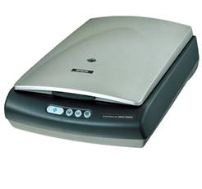
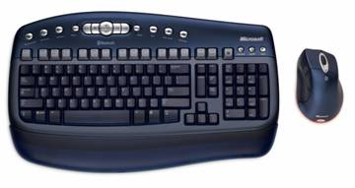
Input Devices
Input Devices: devices that input information into the computer such as a keyboard, mouse, scanner, and digital camera.

Slide 3
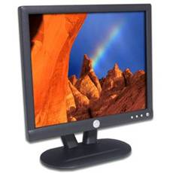
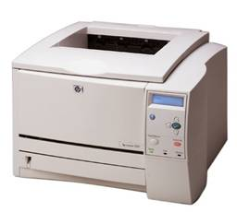
Output Devices
Output: devices that output information from the computer such as a printer and monitor.

Slide 4
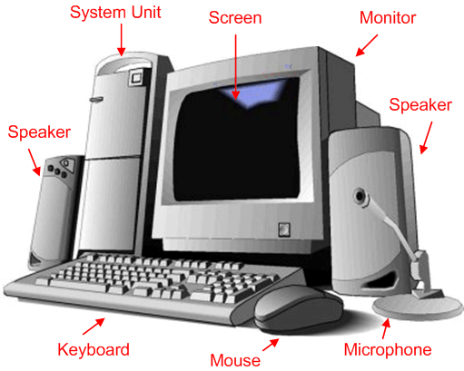
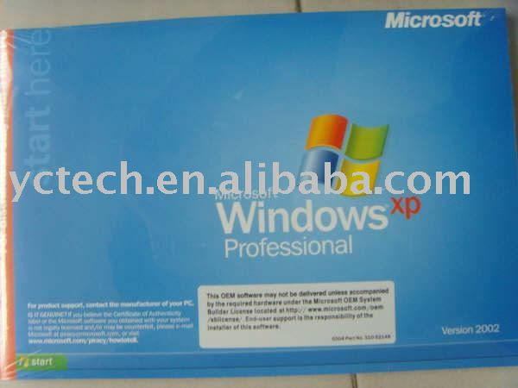
Hardware and Software
Computer Hardware would include all the parts of a computer.
Computer Software includes the programs that are installed.. Or the instructions for completing tasks.

Slide 5
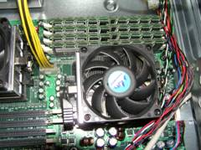
Central Processing Unit
CPU (Central Processing Unit) also called the Microprocessor or “The Brain” of the Computer.
Processor speed: The speed at which a microprocessor executes instructions. This is usually measured in megahertz (MHz).
Brands of Processors include:
Pentium
Celeron
MAC
AMD
Cyrix

Slide 6
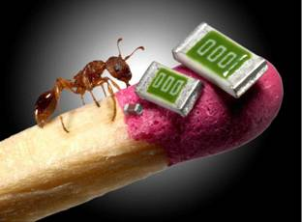
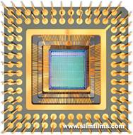
Central Processing Unit
Computer chip: also called the microprocessor may contain an entire processing unit.
Computer chips contain millions of transistors. They are small pieces of semi-conducting material (silicon).
An integrated circuit is embedded in the silicon. Computers are made of many chips on a circuit board.

Slide 7
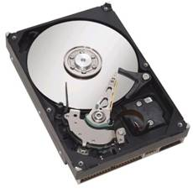
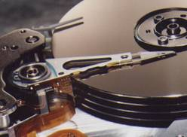
Data Storage Devices
The hard-drive is a mechanical storage device typically located internally.
Fast recording and recovery of data
Large storage capacity
Magnetic
Primary storage device for data and programs
Speed is measured in R.P.M.’s (Revolutions per minute)

Slide 8
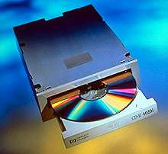
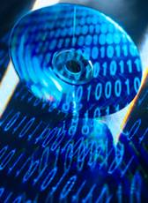
Data Storage Devices (cont’d)
CD-ROM (compact disk read only memory)
An optical device read by a diode laser

Slide 9
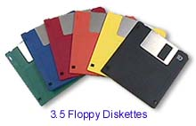
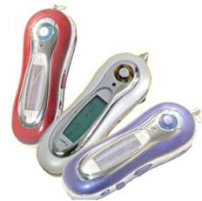
Data Storage Devices (cont’d)
Floppy diskette is magnetic storage device for small amounts of data (1.44MB).
FLASH drive is a compact and portable electronic storage device.
USB (plug and play) supported

Slide 10
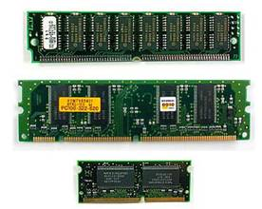
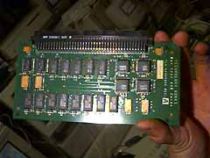
Computer Memory
RAM (random access memory) stores data that is processing. This type of memory is erased when the computer is turned off.
ROM (read only memory) contains special instructions for the computer to operate.
Cache memory increases the speed of the processor by recording and anticipating instructions.

Slide 11
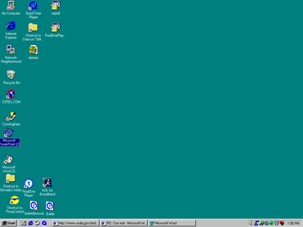
Graphic User Interface (GUI)
GUI (Graphic User Interface) is a set of images and icons seen on the desktop used to operate a program.
The GUI makes the programs loaded on the computer easier to access and use. Basic Windows GUI
Icons are small pictures that represent files, commands, or windows.
Windows is a GUI operating system.

Slide 12
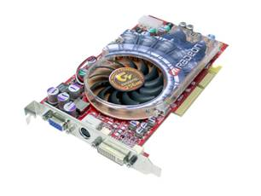
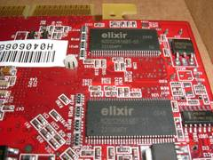
Video Cards
Video cards plug into the motherboard and are used to display video.
VRAM is video memory that enhances the refreshment rate of the image.
Video cards have chipsets that can increase the speed of video display.

Slide 13
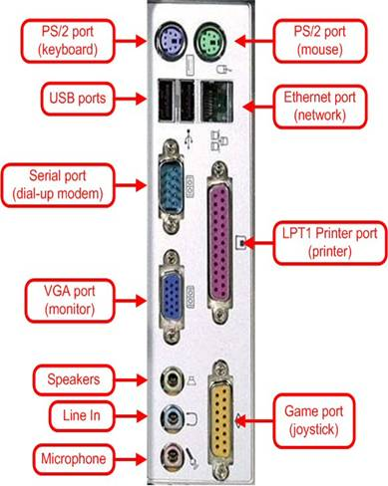
Ports and Peripherals
Ports are an interface between the computer and another peripheral device such as a disk drive, mouse, printer, modem, monitor, camera, FLASH drive or keyboard.
Examples:
Serial
Parallel
hot-wire
USB

Slide 14
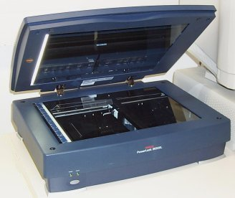
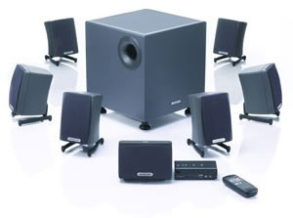
Ports and Peripherals
Peripherals are devices that plug into a computer and are not housed internally.
Examples:
Printers
Scanners
Cameras

Slide 15
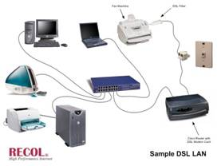
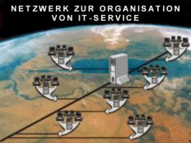
LAN and WAN
LAN: are networks usually in the same company or building. The Local Area Network is connected via telephone lines or radio waves. Most LANs connect workstations.
WAN: are systems of LANs that are connected. (Wide-area network)

Slide 16
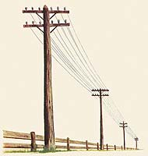
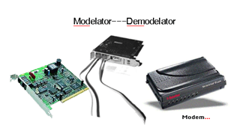
Bandwidth and Baud Rate
Bandwidth is how much information can be carried in a given time period (usually a second) over a wired or wireless communications link.
Baud rate is the rate at which information is transferred in a communication channel.

Slide 17

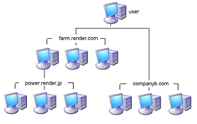
Multitasking and Multiprocessing
Multitasking is the ability to execute more than one task (program) at the same time. Only one CPU is used but switches from one program to another.
In multiprocessing, more than one CPU is used to complete a task. Example: network rendering.

Slide 18
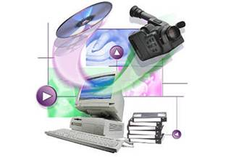

Multimedia
Multimedia software programs include sound, pictures, video, text, and hypertext to create presentations.
Software includes:
PowerPoint
Macromedia Director
FLASH

Slide 19

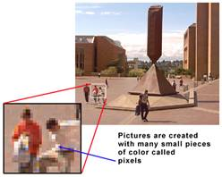
Resolution
Screen resolution is measured in pixel per inch (ppi), and printer resolution is measured in dots per inch (dpi).
Computer screen resolution is approximately 72 ppi.
Width x Height (Pixels) Video Display
640 x 480 Low Resolution
800 x 600 Medium Resolution
1600 x 1200 High Resolution

Slide 20
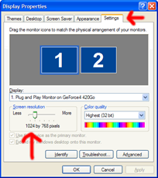
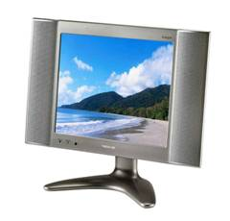
Resolution
Resolution refers to the number of pixels (picture elements) in the monitor image.
Increased resolution uses more computer resources but increases the visual clarity of the display.

Slide 21
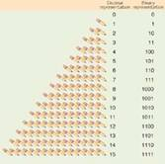
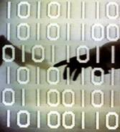
Computer Memory
Computer memory is binary (0 or 1) (on or off).
The byte is the standard unit of measurement.
A byte is composed of 8 bits (binary digits).
Typical units of measurement:
1 KB (kilobyte) = 1000 bytes
1 MB (megabyte) =1000 kilobytes or 1 million bytes
1 GB (gigabyte) =1000 megabytes or 1 billion bytes
1 Tb(Terabyte)= 1000 gigabytes or 1 trillon

Slide 22
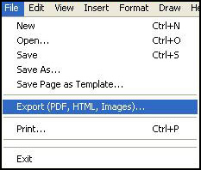
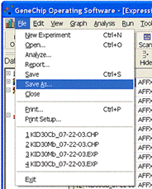
File Management
Saving files - know the difference between “save” and “save as”. “Save” will save the open document over the saved document while “save as” creates a new document if you rename the document. Save often so work will not be lost.
Exporting – converts a native format to a non-native file format used in various software programs. In vector programs, file types may be exported.

Slide 23
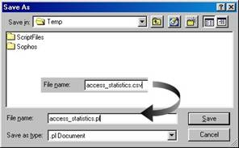
File Management
Different programs have different file extensions.
Naming files - avoid the following characters in naming files:
Examples:
@
*
.
Understand the parts of a path name.
Example: C:\SciVis\movie.avi
Drive designator Directory or folder File name File extension

Slide 24

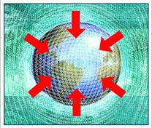
File Management
Merging files - in 3D graphics, bringing an outside file into an open file (another name for this may be loading or replacing objects in the workspace).
Importing files - bringing a converted non-native format file into an open file.

Slide 25
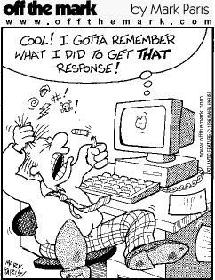
The End

